Slide 1
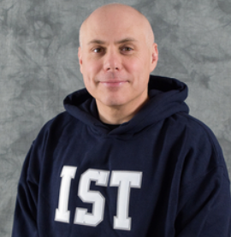
Tools for Better Remote Teaching and Learning
Joe Oakes, Program Chair of IST at Abington
joe.oakes@psu.edu
4/01/2020 Wednesday

Slide 2
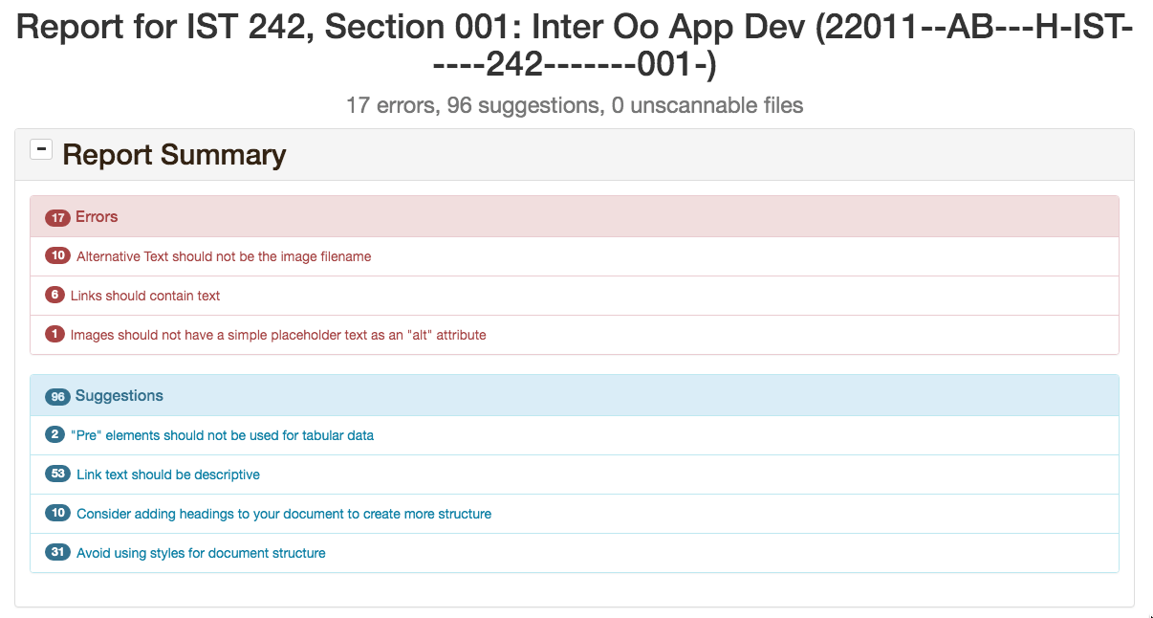
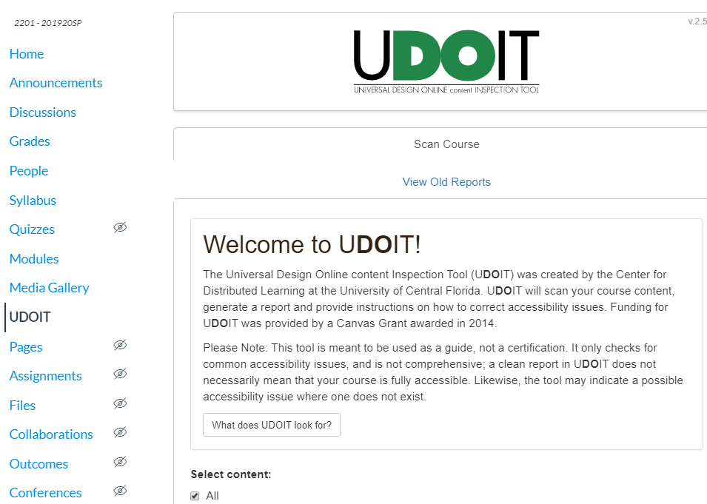
Tools for Teaching and Learning
Accessibility: Compliance: Canvas Universal Design Online Content Inspection Tool
Joe Oakes
Accessibility Compliance
Enable the Canvas tool UDOIT
Settings > Navigation > Enable

Slide 3
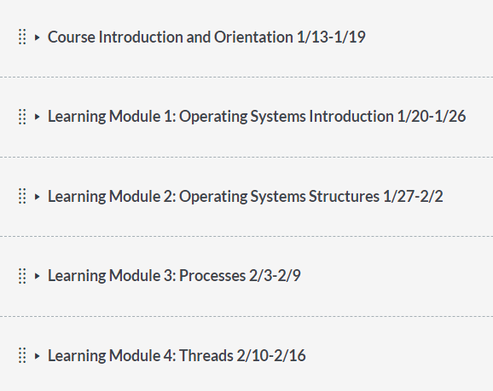
Tools for Teaching and Learning
Accessibility: Quality, Easy, Value -> Methods and Techniques: Learning Modules
Joe Oakes
Organized learning modules in Canvas LMS
Provides a learning pathway
Provides a weekly learning structure
Bundles all the learning resources and content materials together

Slide 4
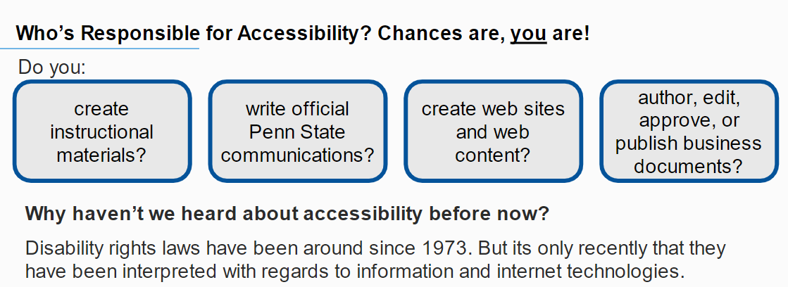
Tools for Teaching and Learning
Accessibility: Compliance Help
Joe Oakes
Accessibility Compliance
Penn State's IT Accessibility Team can test your instructional materials, news, and communications, websites and business reports
Email them at: accessibility@psu.edu

Slide 5
Tools for Teaching and Learning
Generate subtitles for Accessibility
Joe Oakes
Adding real time presentation subtitles to the lecture
This feature is available in Google Slides. Click on the CC button lower left corner of the presentation
This feature is ONLY available using the Microsoft Office 365 Cloud PowerPoint – it is available to all faculty, staff and students

Slide 6
Tools for Teaching and Learning
Real Time Subtitles for Accessibility
Joe Oakes
Adding real time presentation subtitles to the lecture
You can select where the subtitles will appear in real time

