Slide 1
Promotion and Tenure
Workshop 2025-2026
January 2025
Notes:
These slides go over the P&T procedures - we’ll send these out afterwards and they’ll also be on the website for you to refer to.

Slide 2

Promotion and Tenure General Criteria
Scholarship of Teaching and Learning
Scholarship of Research and Creative Accomplishments
Service and the Scholarship of Service to the University, Society and the Profession
Note: PSU’s “Activity Insight” is changing name to
“Watermark Faculty Success”
Notes:
These are the main sections of your dossier – Scholarship of Teaching, Research and Service. We will be reviewing each section in todays presentation.

Slide 3
Confidentiality
Excerpts from Penn State AC23:
…members of the Promotion & Tenure Committee participate with the understanding that all matters related to their deliberations remain confidential.
…all aspects of the promotion and tenure process are confidential.
Important:
Confidentiality of the promotion and tenure process is to be respected forever, not just during that particular year of review.
Notes:
per AC23 Penn States procedures and regulations for P&T- The promotion and tenure process is completely confidential forever.

Slide 4
Multi-Year P&T Timeline
 | 2nd Year | 3rd Year (concern) | 4th Year | 5th Year (concern) | 6th year, full professor, 5th year (early)
 | Provisional Reviews
Reason for Review | 2nd Year Review | Decision by Dean | 4th Year review | Decision by Dean | 6th year- tenure and promotion Full rank – promotion 5th year – Early tenure
External Letters | No |  |  |  | Requires letters from at least four external evaluators
Levels of Review | Stays within the College 3 levels: Department P&T committee, Dept Head, and Dean |  |  |  | Department P&T comm. & Head College P&T comm. & Dean University committee & President
Works in Progress (publications) | Included in dossier |  |  |  | Not included
Grants Submitted, not funded | Included in dossier |  |  |  | Not included Pending grants are included
Notes:
This table provides a general overview of the differences between the earlier tenure reviews and 6th year tenure reviews. IST typically has 2nd, 4th and 6th year reviews. 2nd & 4th year dossiers include works in progress and grants submitted by not funded, 6th year do not include those. 6th year require 4 external letters, goes thru a College and University review, 2nd and 4th year Reviews stay within the College

Slide 5
The Dossier
University document: 2024-2025-Administrative-Guidelines.docx
Information | Responsibility
P&T Recommendation Form | Admin. Support
Biographical Data Form | Candidate
College Criteria Statement | College
Candidate Signature Page | College
Narrative Statement | Candidate
Dossier Sections
Scholarship of Teaching and Learning | Candidate
Scholarship of Research and Creative Accomplishments | Candidate
Service and the Scholarship of Service to University, Society and Profession | Candidate
External Letters of Assessment (6th year review and promotion to Professor) | College
Statement of Evaluation | Departmental P&T Comm & Head College P&T Comm. & Dean
Notes:
For your dossier you are responsible for the Biographical Data Form, Narrative and the Sections on Teaching, Research and Service. We’ll take care of the other information.

Slide 6
Supplemental Materials
Information | Responsibility
Full SRTE/SEEQ Information and student comments for all years of review: 2nd-, 4th-, 6th-level reviews. | Admin. Support
Current Academic Curriculum Vitae​ | Candidate
Top 5 publications for promotion and tenure and for promotion to Professor | Candidate
Important:
Supplemental Materials are the materials that are sent to External Reviewers (not including SRTE/SEEQs).
Unless requested by the University-level review committee during a six-year review, Supplemental Materials stay within the College and are not uploaded into Activity Insight. The CV, publications and preliminary narrative for external Reviewers are not part of the dossier.
The academic CV must include all appointment dates, curriculum development, course innovations, committee work and other service.
Notes:
Supplemental materials stay within the college and don’t go on to University , aren’t loaded into Activity Insight.
Examples are the full SRTE/SEEQ reports. 6th year candidates provide their CV and Top 5 publications.

Slide 7
Biographical Data Form for Promotion/Tenure Review
IMPORTANT:
Please complete the form in its entirety: Please include Exact Rank and Title.
Please complete all fields in Section II: Academic Training including degree dates.
Please complete all fields in Section III: Academic, Government, Military and Professional Positions including Rank or Title and Dates (from-to)
Please complete Section IV: Previous Sabbaticals at the Pennsylvania State University (if applicable).
Notes:
The Biographical Data form is pretty straight forward, for your rank and title just put Assistant Professor

Slide 8
Narrative Statement for your dossier
A narrative statement explains the importance of and relationships among a candidate’s scholarship of teaching and learning; scholarship of research; and scholarship of service to the university, society, and the profession.
It covers your entire research career and is limited to teaching and service while appointed at Penn State.
The purpose of this statement is not to itemize achievements that are listed elsewhere in the dossier. Candidates describe the essence of their work, provide context for their activities, and set out their overall goals and plans. Write in plain language that a professor from any discipline can understand.
IMPORTANT:
2-3 pages (3 pages max; 1600 words max, if not employed in 2020 during COVID) in 10-point font with existing margins in the Activity Insight University Dossier template.
Please do not adjust margins when using the Activity Insight Dossier template.
Have a tenured faculty member and the ADFA read your narrative statement. You may receive constructive feedback.
For more information about the Narrative Statement, see the University’s Guidance for Promotion and Tenure Narratives.
Notes:
Your narrative statement can cover your entire career. It should NOT be used to duplicate information that is found elsewhere in your dossier. You can highlight or give context to items already included in your dossier, as well as highlight anything you want to mention that is not in your dossier. You can also provide context about life circumstances that may have affected research, low citation count, lack of service, etc.
Currently 2000 words maximum, fill out in Activity Insight

Slide 9
Scholarship of Teaching & Learning - Section A
Candidate provides information in all areas on the form with the following exceptions:
  Peer Evaluations – Admin. Support provides and manually includes in dossier. Make sure these happen!
  Evaluation of SEEQ/SRTE Scores and Student Comments – One-page report prepared by pair of profs (Admin Support manually includes in the dossier). NEW
  SEEQ/SRTE Scores are in an Appendix to section – Auto upload into Activity Insight
Important to have SRTE/SEEQ scores for all classes taught onload and overload.
Timeline for included material:
  For tenure consideration: materials would be from date of employment at PSU in a tenure-eligible position.
  For promotion consideration: timeline would be from date of last promotion at PSU or most recent five years, whichever is shorter. Candidates may include the last 10 years of teaching information if they wish (for example, if you had many research releases or sabbatical years without teaching).
  Candidates may include the last 10 years of information if they wish.
Notes:
The candidate will provide most of the information in Scholarship of Teaching. We’ll add your peer evaluations and summary of student comments compiled by the P&T committee. All of your materials in this section will be from your date of hire at Penn State. Remember, no SRTEs from SP 20, if you included FA20 SRTEs in an earlier review you have to include them in later dossiers. This won’t affect most of you.

Slide 10
COVID adjustments
Alternate Assessment of Teaching Effectiveness
The Alternate Assessment of Teaching Effectiveness is no longer required for the promotion and tenure dossier.
However, if it was included in an earlier review it should remain in subsequent reviews as it may be referred to in the narrative statement or letters.
COVID SRTE Exclusions
SRTEs from Spring 2020 are not allowed to be included in the dossier.
Only the individual faculty member has access to their Spring, Summer, and Fall 2020 SRTEs. If your Fall 2020 SRTEs were included in your dossier, they must also be included in all subsequent dossiers.
Narrative
Narrative length can be a bit longer, up to 2000 words, for candidates pursuing tenure who were in their probationary period in calendar year 2020.
2019/20
2020/21
2021/22
2022/23
2023/24
2024/25
2025/26
2026/27
Notes:
The Alternate Assessment is no longer required, however if it was included in an earlier review, you must keep it in for later reviews as it may have been referred to in the narrative statement or letters. Same is true for FA20 SRTEs

Slide 11
Scholarship of Research and Creative Accomplishments – Section B
Candidate provides all information for this section.
The Research Administration Office can provide a summary of information regarding funded projects. (Reminder: gifts from industry or grants internal to Penn State may not show up on the Research Office list. You will then need to supply that information.)
All publications that have a status of ‘in-press’ or ‘accepted’ need to have documentation to confirm that status.
Grants and Contract information is updated in Activity Insight the second Monday of every month.
Proposals submitted but not funded should be included in 2nd and 4th year dossiers only.
Manuscripts in progress should be included in 2nd and 4th year dossiers only.
Timeline for included material covers candidate’s entire career, including before PSU.
Notes:
Scholarship of Research covers your entire career, not just what has been done since you were hired at Penn State. Grants are automatically imported to Activity Insight and are imported by the OSP number. Review your grants to make sure everything is correct and all are included. For any accepted publications we’ll need the proof of acceptance email you’ve received and we’ll add it to your dossier.

Slide 12
Service and the Scholarship of Service to the University, Society and the Profession – Section C
Candidate provides all information.
Timeline for included material:
  For tenure consideration, dossier will include material from date of employment at Penn State in a tenure-eligible position.
  For promotion consideration, dossier will include material from date of last promotion at Penn State or most recent five years – whichever is shorter. Candidates may include the last 10 years of service information if they wish.
Notes:
The candidate provides all material for Scholarship of Service beginning with date of hire at Penn State.

Slide 13
External Letters of Assessment
The candidate will submit 5 or 6 names of potential external letter writers including title, university affiliation, brief bio statement, and email address.
Do not include anyone who has been a supervisor, coauthor, proposal collaborator, or good friend.
The Departmental P&T Committee, Head, and the College P&T Committee may also provide lists of external letter writers. The Dean will review the names and decide which external letter writers to contact.
The Dean’s Office will oversee the process of obtaining external letters of assessment. Candidates are not to contact potential external letter writers.
This section will remain confidential to the candidate for all time.
**It is NOT appropriate for a candidate to contact potential letter writers either before or after the process – including contacts to “solicit their availability to write a letter.” For more information refer to the Promotion and Tenure FAQs document, question number 58.
Notes:
6th year candidates will submit 5-6 names to be a possible external letter writer. You will need to provide the following information individual name and title, university affiliation along with university address, brief bio statement & individuals email address. The Departmental P&T Committee and the College P&T committee also compile a list of names and the Dean makes the final selection of who to contact.. External letters are added to the dossier by admin support. Candidates should not contact potential letter writers. Candidates will never be able to see the external letters.

Slide 14
Statements of Evaluation of the Candidate by Review Committees and Administrators
Final section of the dossier
Letters in this section is generated by the:
  Departmental Promotion and Tenure Committee (peers)
  Head of Department (admin)
  College Promotion and Tenure Committee (peers)
  Dean (admin)
For example, letters from 2nd and 4th year reviews are included in the 6th year dosser.
Notes:
Final section of the dossier are the committees and Dean letters of review - 2nd and 4th year candidates will get copies of the committees’ letters and the Deans letter in late spring. These carry forward into future dossiers.

Slide 15
Timeline
After submission, the administrative assistant will review your dossier and tell you if changes need to be made. All changes should be made no later than the date given in the timeline. If the dossier is submitted on the due date, you will have approximately one-to-two weeks to make the requested edits. Consider sending in your dossier before the due date for more time to refine.
All edits should be made in Activity Insight (Watermark)
Common revisions typically include:
  For multiple-authored works the role and percentage of contribution of the candidate should be clearly indicated.
  All publications that have a status of ‘in-press’ or ‘accepted’ need to have documentation to confirm that status. Send that documentation to the administrative assistant.
  Presentations will need a role for each entry.
  Make sure formats for all entries in the ‘Research’ section are as consistent as possible. For example, publications should include the information listed below:
    Multiple authors, contribution type, percentage of contribution, year, title, journal name, page numbers, volume/issue
Notes:
We’ll notify you of the timeline for your year of review. Please try to be early if possible with your dossier, we have to review the materials and let you know what changes need to be made. All edits take place in Activity Insight, that’s where we pull the dossier from.

Slide 16
2nd Year Review
(Please note** if the date below falls on a weekend the due date will be on the closest business day.)
No later than December 1st
No later than January 15th
February 1st
April ^{1st}
No later than May 8th or Friday before commencement
2nd year candidate submits dossier to Dean’s Office Administrative Assistant for preliminary review
2nd year candidate submits dossier to Dean’s Office Administrative Assistant for final review + inclusion of Fall SEEQ data
All factual changes or new information must be submitted by this date.
P&T Review completed by Departmental committee and Department Head and forwarded to IST Dean
Candidates notified of results of review
Note: this timeline would also be used for a 3rd year reviews. ​
Notes:
We must have the 2nd year dossiers by Dec 1st for first review, by Jan 15th the fall SEEQ data should load in AI and the candidates review and sign off on the dossier. Then the dossier goes thru the committee review and Department Head review. Feb 1st deadline for new factual information. Early May you will be notified of the results.

Slide 17
4th Year Review
(Please note** if the date below falls on a weekend the due date will be on the closest business day.)
No later than September 8th
Candidate submits dossier to Dean’s Office Administrative Assistant
February 1st
All factual changes or new information must be submitted by this date
No later than May 8th or Friday before commencement
Candidates notified of results of review
P&T review completed and forwarded to IST Dean by February 14th
April 1st
P&T Review completed and forwarded to IST Dean
Departmental committee reviews dossiers in October and finalizes review by November 22nd, moves to Department Head
Note: this timeline would also be used for a 5th year review.
Notes:
4th year candidate dossiers are due no later than September 8^{th.}
Once reviewed and signed off on the dossier moves to the committee for review and then to the Department Head. Feb 1st deadline for new factual information. Early May you will be notified of the results.
Be thorough in first prep. Avoid adding “factual changes or new information.” Any change to the dossier requires a second signature and all letters to be rewritten (two of each in dossier is distracting--bad signal).

Slide 18
6th Year Review, Promotion to Professor, 5th Year (early/out of sequence)
March 1st (2025)
Candidate submits to the Dean’s Administrative Assistant required materials below. This is done in preparation for sending information to external evaluators.
July 1st (2025)
Dossier submitted to Dean’s Administrative Assistant
March 1st (2026)
No later than May 8th or Friday before commencement
College level reviews completed and forwarded to University P&T Committee
Candidates notified of results of review
Academic CV
Narrative Statement
5 best (representative) papers
Names of 5-6 potential external evaluators
College P&T Committee review completed and sent to Dean
January 17th (2026)
April 15th (2025)
Candidate can submit revised materials (to be forwarded to external reviewers.)
Departmental P&T committees receive materials in September, complete their review by October 11th , then moves to Department Head
February 1st All factual changes or new information must be submitted by this date
Note:
If the dates above falls on a weekend the due date will be on the closest business day.)
Having the dossier complete and accurate by the July 1st date alleviates having to rewrite with looming deadlines.
Notes:
6th year review -Because the process spans more than one year, we have indicated how the timeline overlaps. March 1st candidates submit CV, narrative and 5 best papers AND 5-6 names of external letter writers. They can update these materials thru April 15th. July 1st their dossiers are due. Once reviewed and signed off of the dossier moves to the committees for review. Feb 1st deadline for new factual information. By March 1st the dossiers move to the University. Early May you will be notified of the results.

Slide 19
Staying of the Provisional Tenure Period
Upon the written request of a faculty member, the Executive Vice President and Provost may grant a temporary staying of the tenure provisional period, if in his/her judgment, the academic performance of the provisional faculty member would be adversely affected by: the responsibility as primary caregiver after the birth or adoption of a child, a serious personal illness, the provision of care for a seriously ill family member, or any similar situation.
This special exception would be for one academic year and would normally be granted no more than twice, for a provisional faculty member seeking tenure.
At the end of the stayed year the faculty member would continue on the tenure track.
** See appendix G of University Guidelines
Notes:
A request for a stay of the tenure period has to be submitted in writing and approved by the Provost.

Slide 20
Please remember…
Read AC-23 policy and it’s Guidelines (responsibility of the candidate to read material associated with P&T).
Follow each section within the dossier; ensure consistency and thoroughness within each section.
Use Activity Insight Digital Measures (Watermark) to populate your dossier and to make any requested changes. https://activityinsight.psu.edu/
Everything listed is most recent date first (classes taught, articles published, etc.).
Please note everything must be factual (when in doubt, leave it out). If a section does not apply, don't use it.
Please consult with Kathy Wiest for questions.
“Faculty candidates under review are discouraged from approaching committee members at any time concerning the disposition of their review and should understand that inquiries of this type are deemed entirely inappropriate.”
Invite your colleagues and ADFA to review and comment on your narrative.
Start early. You will need to allow yourself time to input your data into Activity Insight. Administrative support staff cannot enter the data.
Notes:
Please remember Read the AC-23 University Guidelines for P&T. Use Activity Insight to populate your dossier. AI has a team that is very responsive if you need help. Everything in the dossier is listed in most recent date order. Start early so you have time to do a thorough job. Candidates under review are discouraged from approaching the P&T committee about their review. Please contact me if you have questions.

Slide 21
Activity Insight
All promotion and tenure dossiers must be created using the Faculty Activity Insight (FAIS) Digital Measures Database
(renaming: Watermark Faculty Success)
Training and Frequently Asked Questions:
https://activityinsight.psu.edu/
Notes:
Here’s the link for activity insight, they have trainings and frequently asked questions on the sight.

Slide 22
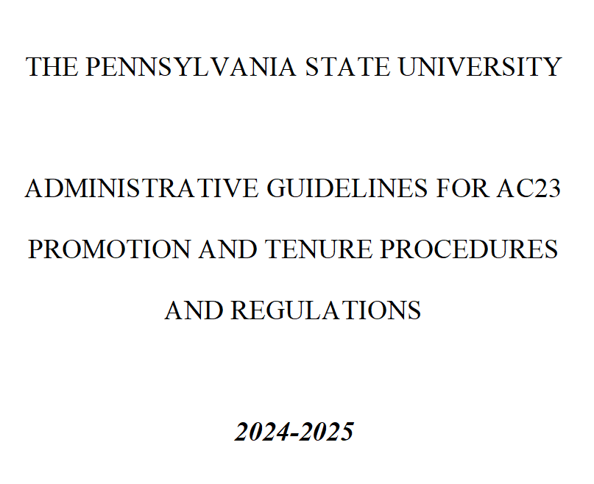
AC-23 Penn State Promotion and Tenure Procedures and Regulation
Read Penn State Policy AC-23
Promotion and Tenure Procedures and Regulations
https://policy.psu.edu/policies/ac23
Read the Administrative Guidelines for AC-23 for current year (70 pp. !)
https://facultyaffairs.psu.edu/files/2024/09/2024-2025-Administrative-Guidelines-3.pdf
Notes:
Here is the link for AC-23 Penn States P&T Procedures and Regulations. The Penn State Faculty Affairs Office also has more information on their site.
https://facultyaffairs.psu.edu

Slide 23
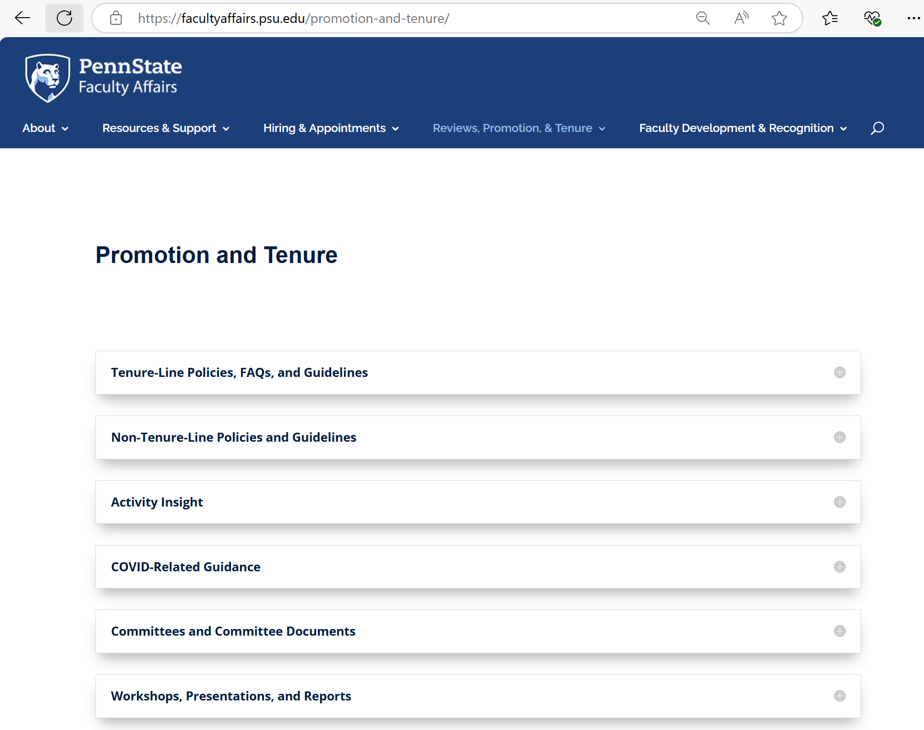
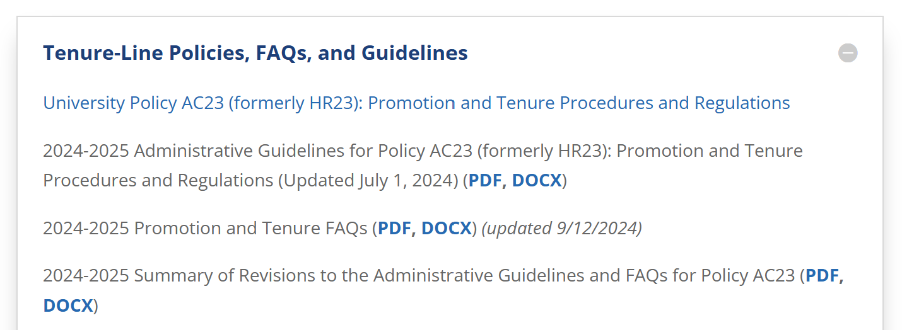
Get to know the Vice Provost for Faculty Affairs website
https://facultyaffairs.psu.edu/promotion-and-tenure/

Slide 24
Promotion and Tenure Committee Comments
Narrative
  Articulate the vision, current accomplishments, and your plan in research section of your narrative.
  In the teaching section of your narrative, articulate your contributions to student learning, how you made adjustments/efforts to improve teaching based on student/peer feedback, and curriculum development/enhancement efforts you contributed.
Research
  Completeness of co-authors in publications.
  Correct publication category of workshop papers (recommended category: Other)
  Clear indication of poster papers (and/or short papers) of refereed conferences.
  Clear indication of a workshop affiliated with a conference: in Proceedings of Workshop on XXX, <Conference Name>.
Funding
  For some, it can be useful to articulate the nature of their research work in relation to research funding.
  Completeness of PI/co-PI list in funding/grant. Indicate your role (PI/co-PI/Senior Personnel, etc.)
  For collaborative proposals, list other institutions involved (their amount) and which one is the lead.
Teaching
  Clearly describe your mentoring activities - graduate / undergraduate, advising roles (sole advisor or co-advisor), and impacts (students’ accomplishments, jobs, etc.)
  Keep records of students’ written comments that were emailed to you. (These emails/cards are not included in dossiers but may be reflected on in narrative.)
Notes:
This is some advice from past P&T committees.

Slide 25
Summary
The Road to Promotion and Tenure
Organize your information.
Start early.
Ask questions.
Submit completed dossier on schedule.

